Slide 1
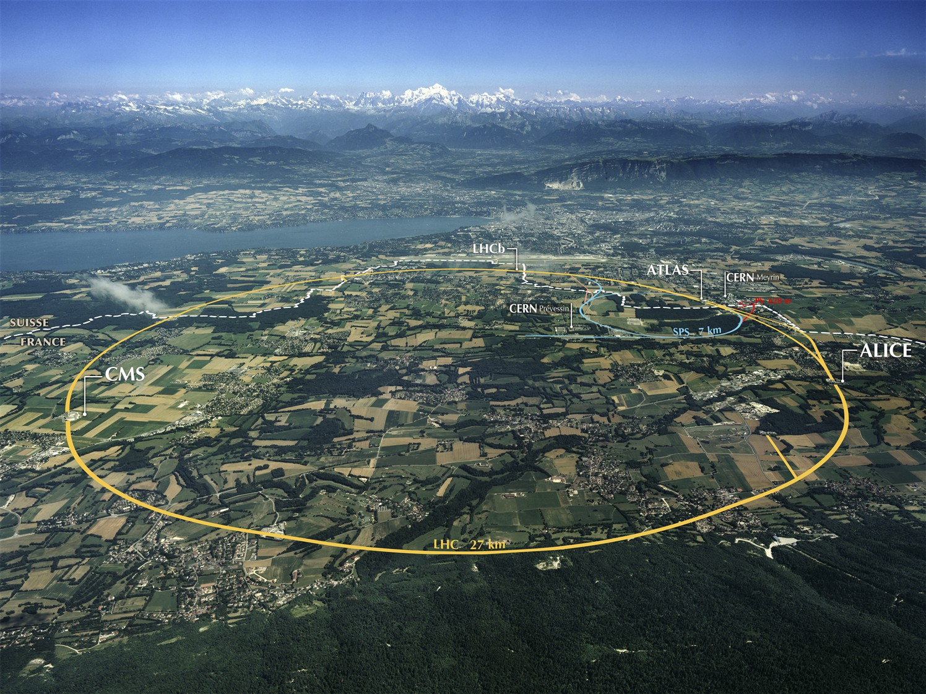
LHC Status & Plans

Slide 2
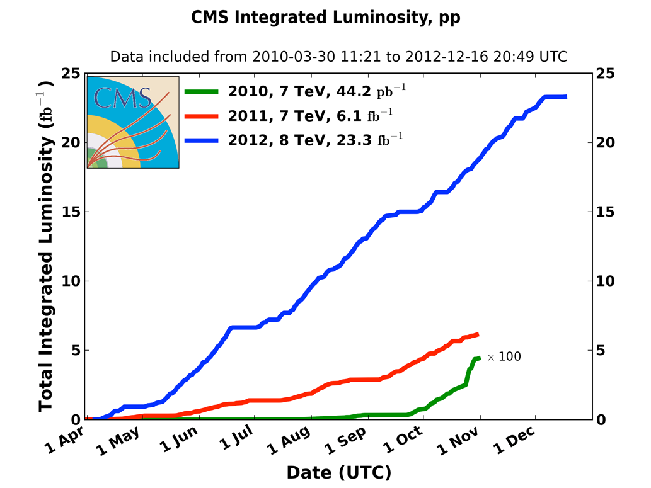
Integrated pp luminosity 2010-12
2010 : E_{cm}=7 TeV
L=0.04 fb⁻¹
2011 : E_{cm}=7 TeV
L=6.1fb⁻¹
2012 : E_{cm}=8 TeV
L=23.3 fb⁻¹

Slide 3
Performance through the year
 | 2010 | 2011 | 2012 | Nominal
bunch spacing [ns] | 150 | 50 | 50 | 25
no. of bunches | 368 | 1380 | 1380 | 2808
beta* [m] ATLAS and CMS | 3.5 | 1.0 | 0.6 | 0.55
max. bunch intensity [protons/bunch] | 1.2 x 10¹¹ | 1.45 x 10¹¹ | 1.7 x 10¹¹ | 1.15 x 10¹¹
normalized emittance [mm-mrad] | ~2.0 | ~2.4 | ~2.5 | 3.75
peak luminosity [cm⁻²s⁻¹] | 2.1 x 10³² | 3.7 x 10³³ | 7.7 x 10³³ | 1.0 x 10³⁴
>2x design when scaled to 7 TeV!

Slide 4
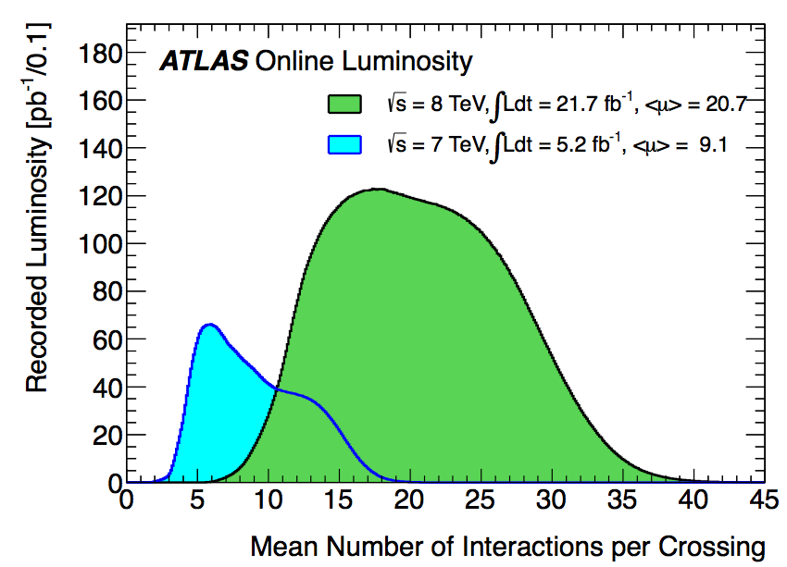
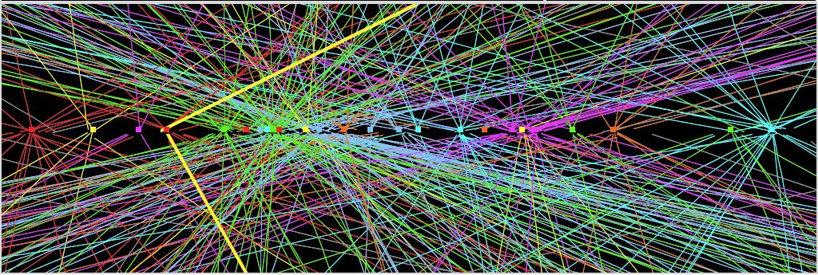
A challenge in RUN-I - pile up events
pile up will increase at higher energy →
experiments request 25 ns operation
in 2015
2012
2011
Z→ μμ event from 2012 data with 25 reconstructed vertices
ATLAS

Slide 5
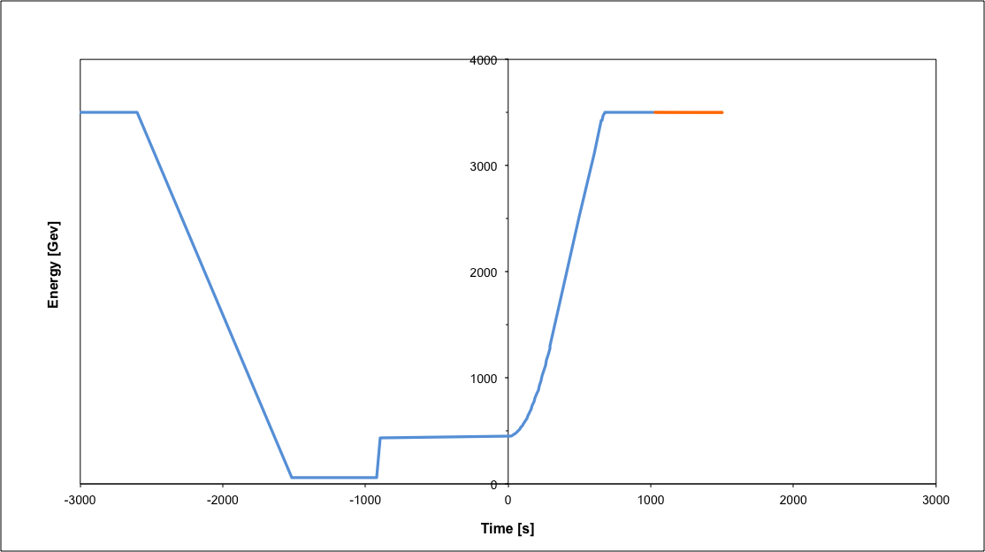
Operational cycle
Beam dump
Squeeze
Stable beams
Collide
Ramp down | 35 mins
Injection | ~30 mins
Ramp | 12 mins
Squeeze | 15 mins
Collide | 5 mins
Stable beams | 0 – 30 hours
Ramp
Ramp down/precycle
Injection
turn around 2 to 3 hours on a good day

Slide 6
LHCb
luminosity leveling at around 4•10³² cm⁻²s⁻¹ via transverse separation (with a tilted crossing angle)

Slide 7
Run-II: 2015
energy: 6.5 TeV (magnet retraining)
bunch spacing: 25 ns
pile-up considerations
injectors potentially able to offer nominal intensity with even lower emittance
uncertainties for 2015:
electron cloud
UFOs
both get more difficult at 25 ns & at higher energy
energy (limited by retraining)
 | Number of bunches | Ib LHC FT[1e11] | Emit LHC [um] | Peak Lumi [cm-²s⁻¹] | ~Pile-up | Int. Lumi per year [fb⁻¹]
25 ns low emit | 2520 | 1.15 | 1.9 | 1.7e34 | 52 | ~45
expected maximum luminosity from inner triplet heat load (collisions debris) 1.7×10 ³⁴ cm⁻²s⁻¹ ±20%

Slide 8
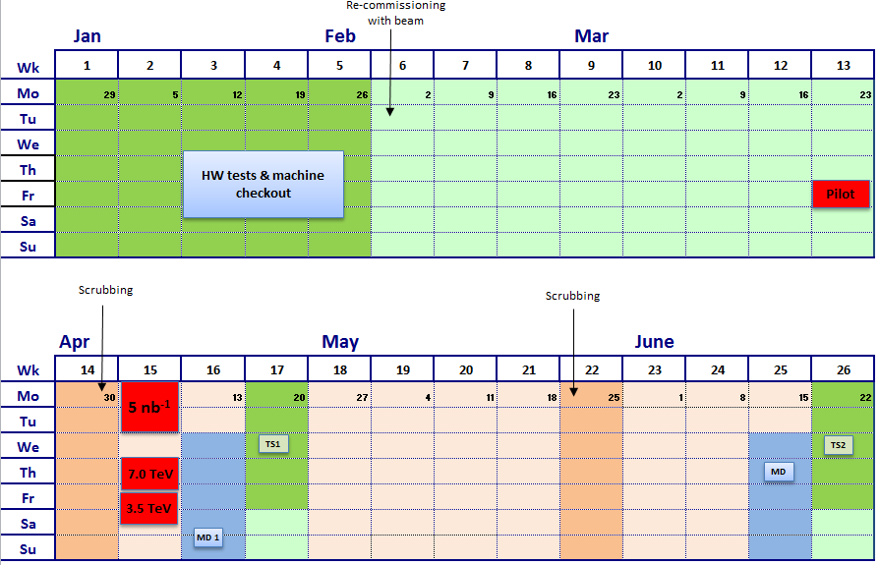
draft 2015 shedule
in red beam time requested by LHCf

Slide 9
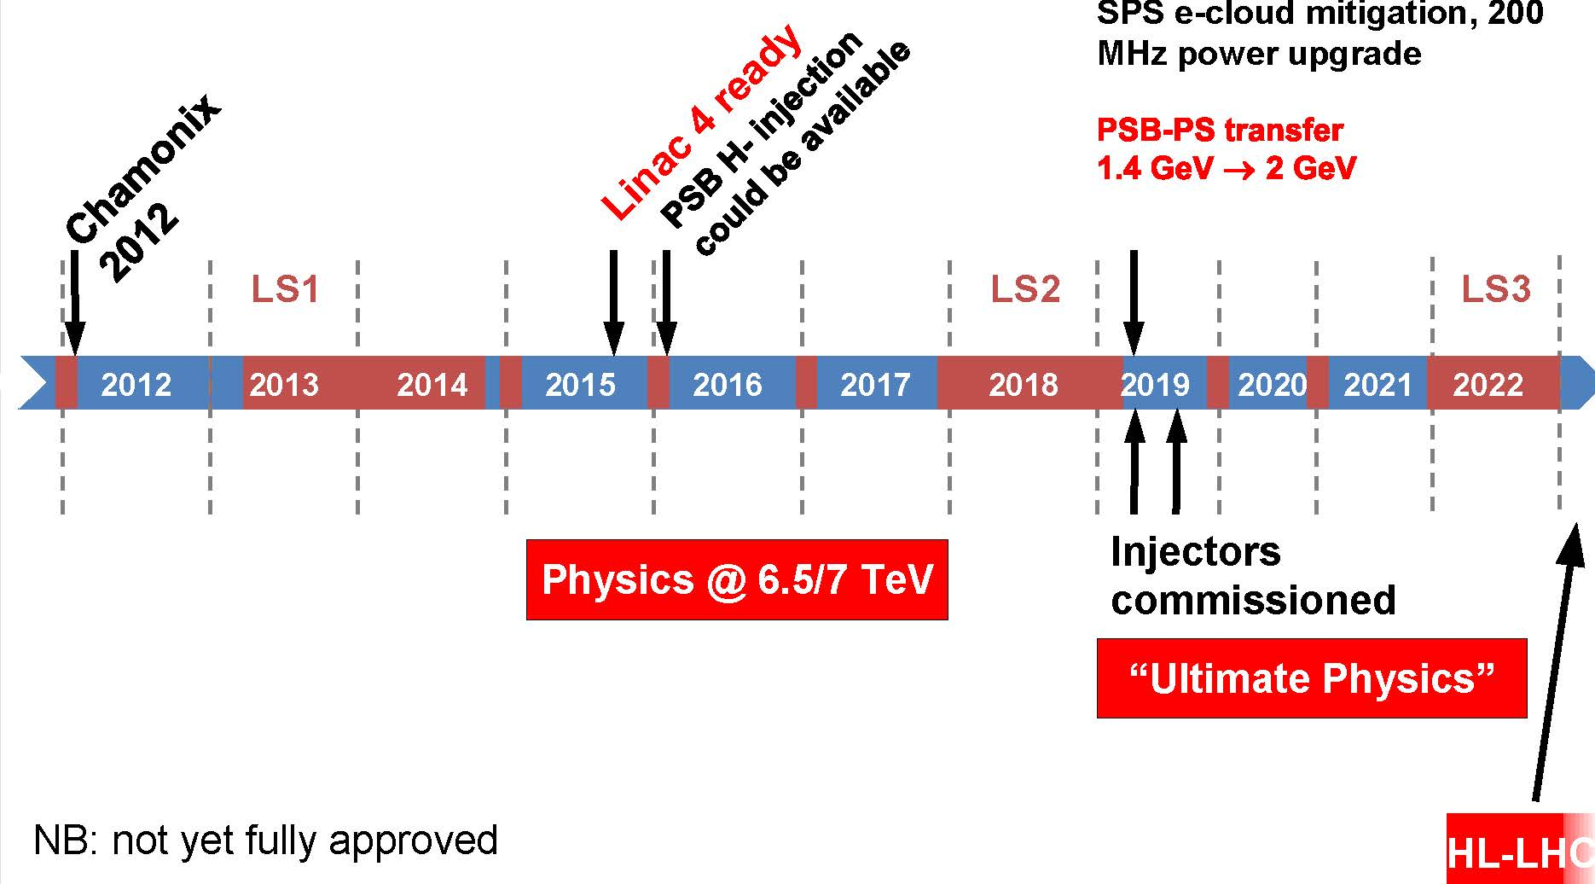
Plan for next 10 years

Slide 10
Luminosity forecast for next 10 years
~30/fb at 3.5 & 4 TeV
~400/fb at 6.5-7 TeV
~3000/fb at 7 TeV
2012 DONE
2021 goal (?)
2035 goal (??)
to obtain 3000/fb by 2035
we need the HL-LHC

